Slide 1
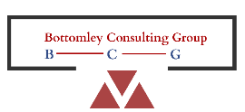
OPTIMISING A CLINICAL TRIAL DESIGN FOR MARKET ACCESS:
A CASE STUDY IN A RARE PEDIATRIC PATIENT POPULATION IN ONCOLOGY
In collaboration with

Slide 2
CHALLENGE
Our client is planning for a registrational clinical trial in a rare pediatric oncology patient population with very high unmet need
It is difficult to generate robust evidence to support market access when conducting trials in pediatric patients, most of which are <5 yrs old
It is critical to ensure that the evidence generated meets payers' needs, and also substantiates a differentiated value proposition

Slide 3
APPROACH: Firstly, extensive desk research was conducted to identify payer requirements and value drivers to maximise HTA acceptability
Review of regulatory & HTA assessments
Identification of accepted study designs
Identification of payer relevant endpoints
Identification of appropriate levels of follow up
Potential pediatric HTA assessment pathways
Additional evidence generation needs

Slide 4
APPROACH: Secondly, defining the optimal PRO strategy
ALIGNED WITH NEEDS OF REGULATORS & HTAs
BALANCED THE NEED
REVIEWED THE LITERATURE
Balanced good quality data with low burden
Used age-appropriate tools for children
Understood what FDA, EMA and HTA bodies expect
Chose tools that support trial goals, labelling and HTA decision making
Explored tools used in similar diseases and trials
Ensured tools are reliable and meaningful for patients

Slide 5
APPROACH: Finally, in depth interviews with payer experts
Confirm findings from the desk research
Gather further critical payer insights
Further refinement of the
clinical trial design

Slide 6
OUTCOME
Provided clear recommendations on the clinical trial design and further evidence generation to maximise the likelihood of HTA acceptance
Detailed potential HTA assessment pathways to inform market access strategies that take account of greater uncertainties
Strengthened our client’s clinical development & market access strategy by addressing key stakeholders needs to maximise the likelihood of market access and pricing success across markets

Slide 7
FEEDBACK FROM THE CLIENT
The extremely professional approach proposed by the team of experts at iPATH Solutions, Wave Market Access Solutions and Bottomley Consulting Group provided us with actionable insights to optimize the design of our clinical trial and our market access strategy, which will help us to bring an innovative solution to children who have a very high need for a more effective and tolerable treatment
JCG, Client’s Head of Market Access & Pricing

Slide 8
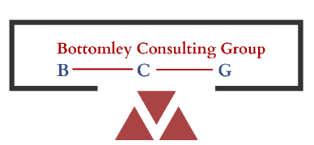
www.wavemarketaccess.com
www.Andrew-Bottomley.com

